Slide 1
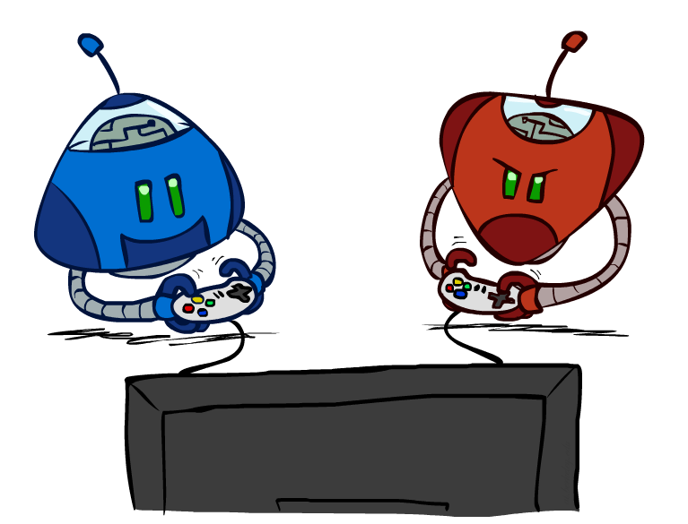
Artificial Intelligence
Game Playing
Acknowledgments: Stuart Russell and Dawn Song
University of California, Berkeley
Notes:
Please retain proper attribution and the reference to ai.berkeley.edu. Thanks!

Slide 2
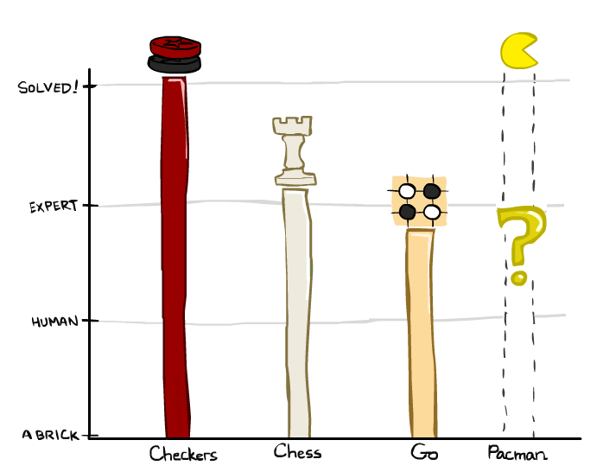

A brief history
Checkers:
1950: First computer player.
1959: Samuel’s self-taught program.
1994: First computer world champion: Chinook defeats Tinsley
2007: Checkers solved! Endgame database of 39 trillion states
Chess:
1945-1960: Zuse, Wiener, Shannon, Turing, Newell & Simon, McCarthy.
1960s onward: gradual improvement under “standard model”
1997: Deep Blue defeats human champion Garry Kasparov
2022: Stockfish rating 3541 (vs 2882 for Magnus Carlsen 2015).
Go:
1968: Zobrist’s program plays legal Go, barely (b>300!)
1968-2005: various ad hoc approaches tried, novice level
2005-2014: Monte Carlo tree search -> strong amateur
2016-2017: AlphaGo defeats human world champions
Pacman
Notes:
Tinsley lost only 5 games to humans in 42 years; has been known to solve 60-ply problems

Slide 3
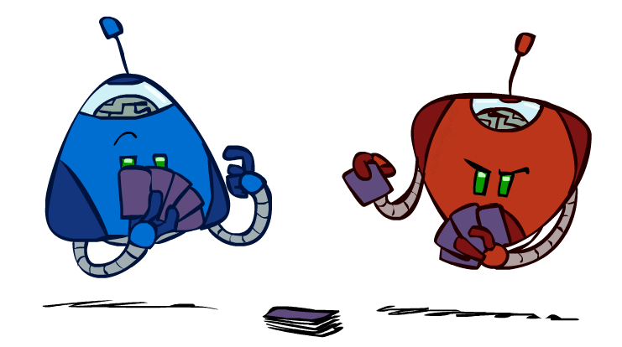
Types of Games
Game = task environment with > 1 agent
Axes:
Deterministic or stochastic?
Perfect information (fully observable)?
Two, three, or more players?
Teams or individuals?
Turn-taking or simultaneous?
Zero sum (good for one and bad for the other)?
Want algorithms for calculating a contingent plan (a.k.a. strategy or policy) which recommends a move for every possible eventuality

Slide 4
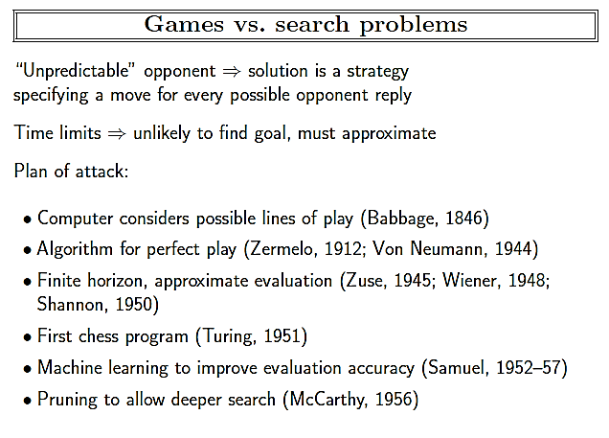

Slide 5
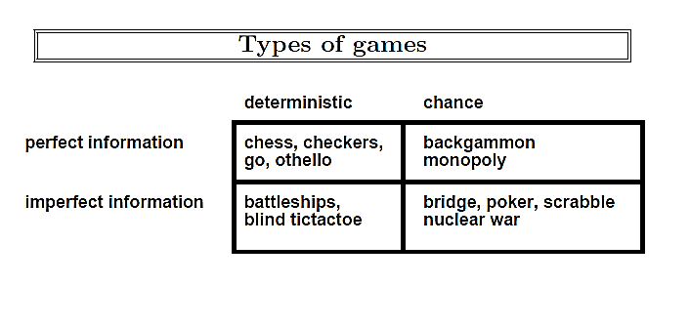

Slide 6
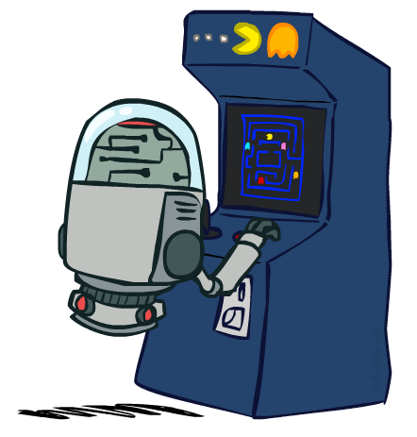
“Standard” Games
Standard games are deterministic, observable, two-player, turn-taking, zero-sum
Game formulation:
Initial state: s₀
Players: Player(s) indicates whose move it is
Actions: Actions(s) for player on move
Transition model: Result(s,a)
Terminal test: Terminal-Test(s)
Terminal values: Utility(s,p) for player p
Or just Utility(s) for player making the decision at root

Slide 7
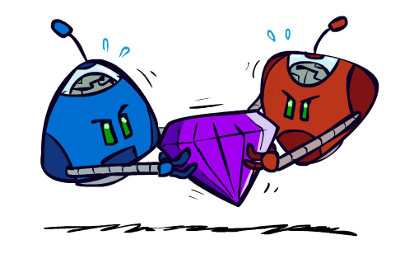
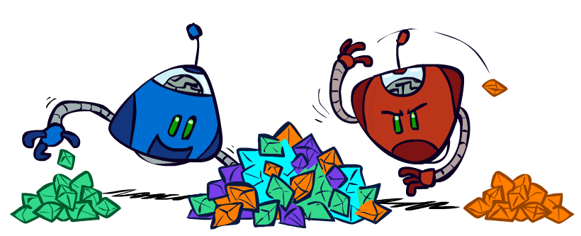
Zero-Sum Games
Zero-Sum Games
Agents have opposite utilities
Pure competition:
One maximizes, the other minimizes
General-Sum Games
Agents have independent utilities
Cooperation, indifference, competition, shifting alliances, and more are all possible
Team Games
Common payoff for all team members

Slide 8
Two-player zero-sum games
The games most commonly studied within AI (such as chess and Go) are what game theorists call deterministic, two-player, turn-taking, perfect information, zero-sum games.
“Perfect information” is a synonym for “fully observable,”
“zero-sum” means that what is good for one player is just as bad for the other: there is no “win-win” outcome.
For games we often use the term move synonym for “action”
Position as a synonym for “state.”

Slide 9
Two-player zero-sum games
‘We will call our two players MAX and MIN.
MAX moves first, and then the players take turns moving until the game is over.
At the end of the game, points are awarded to the winning player and penalties are given to the loser.

Slide 10
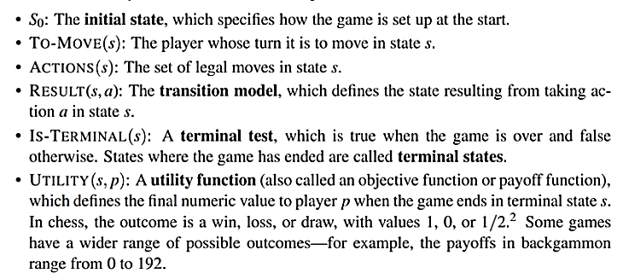
A game can be formally defined with the following elements:

Slide 11
Game Tree
We define the complete game tree as a search tree that follows every sequence of moves all the way to a terminal state.
The game tree may be infinite if the state space itself is unbounded or if the rules of the game allow for infinitely repeating positions.

Slide 12
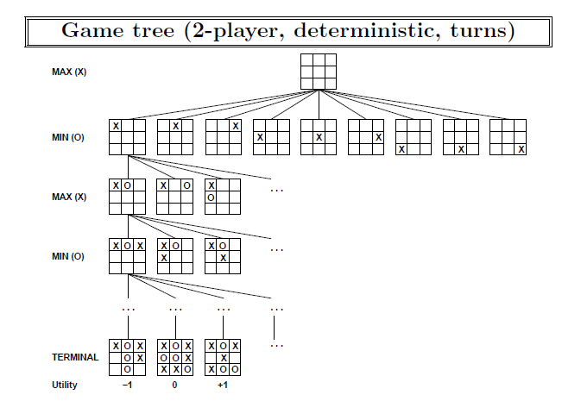

Slide 13
Optimal Decisions in Games
MAX wants to find a sequence of actions leading to a win, but MIN has something to say about it.
This means that MAX’s strategy must be a conditional plan—a contingent strategy specifying a response to each of MIN’s possible moves.
In fact, for such games, desirable outcome must be guaranteed no matter what the “other side” does.

Slide 14
Given a game tree, the optimal strategy can be determined by working out the minimax value of each state in the tree, which we write as MINIMAX(s).
The minimax value is the utility (for MAX) of being in that state, assuming that both players play optimally from there to the end of the game.
The minimax value of a terminal state is just its utility

Slide 15
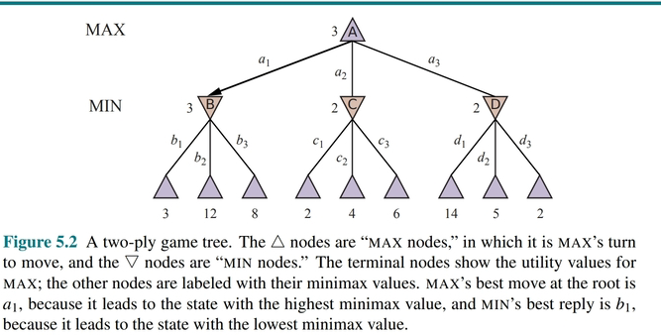

Slide 16
Two Player Game
yes
Opponent’s Move
Generate New Position
Game Over
No
Generate Successor
Evaluate Successor
Move to highest value successor
Game Over
No
yes

